Slide 1
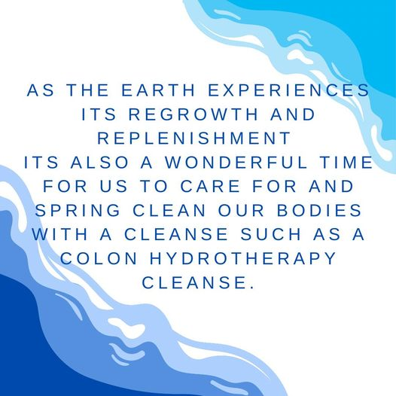

Slide 2


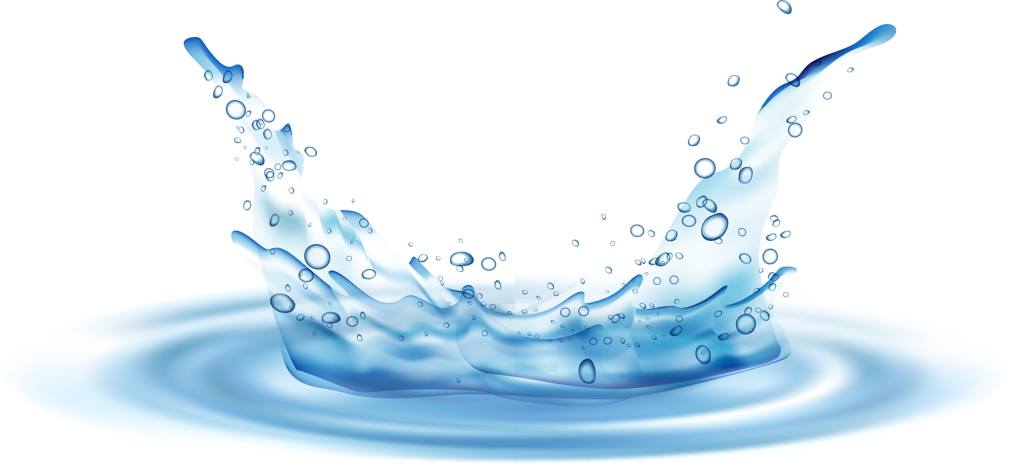
Gallagher Wellness
Center

Slide 3
SERVICES Page
Framework

Slide 4
FAQ Page
Framework

Slide 5
Come Visit Us
Send an Email or Message
Please feel free to send me a message via the contact form and I will follow up with you and answer any other questions you may have within 24 to 48 hours.

Slide 6
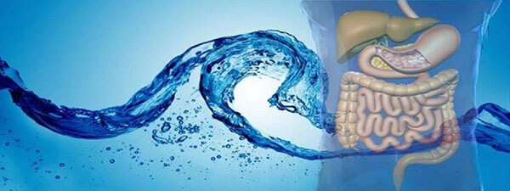
Colon Hydrotherapy is a method of restoring and maintaining the body’s
natural peristaltic rhythm which has become sluggish over time due to various reasons. This holistic approach to cleansing the digestive tract via the large intestine has been an alternative choice for thousands of years. Colon Hydrotherapy eliminates the use of laxatives, seeking a non dependant course of action to a healthy colon.
A toxic bowel is the source of many health problems. Colon cleansing activates the body’s self-healing processes, thereby allowing more efficient waste elimination and nutrient absorption.
Both are essential to a lasting rejuvenation process. This is also the first step toward normalizing the colon, so friendly bacteria can return keeping the colon safe and healthy.
Colon Hydrotherapy

